Slide 1
Tidy Data
SSEP 2022 Morning Day 3
Dr. Ab Mosca (they/them)
Slides based on slides courtesy of Jordan Crouser: https://jcrouser.github.io/MassMutual-IntroR/, https://jcrouser.github.io/MassMutual-DataVis/, https://beanumber.github.io/sds192/

Slide 2
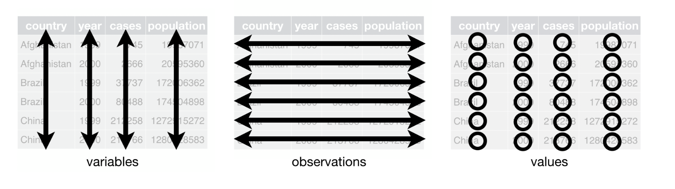
Table Vocabulary
columns
rows
cells

Slide 3
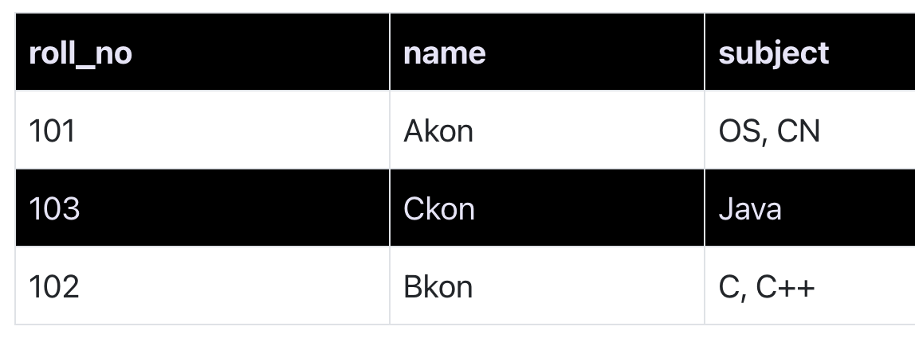
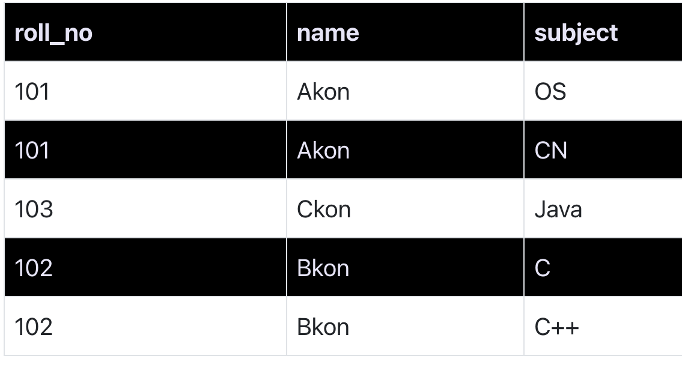
First Normal Form
Definition
Each cell contains one value
All values in one column are of the same type
Columns have unique names
Order in which data is stored does not matter
Ex.

Slide 4
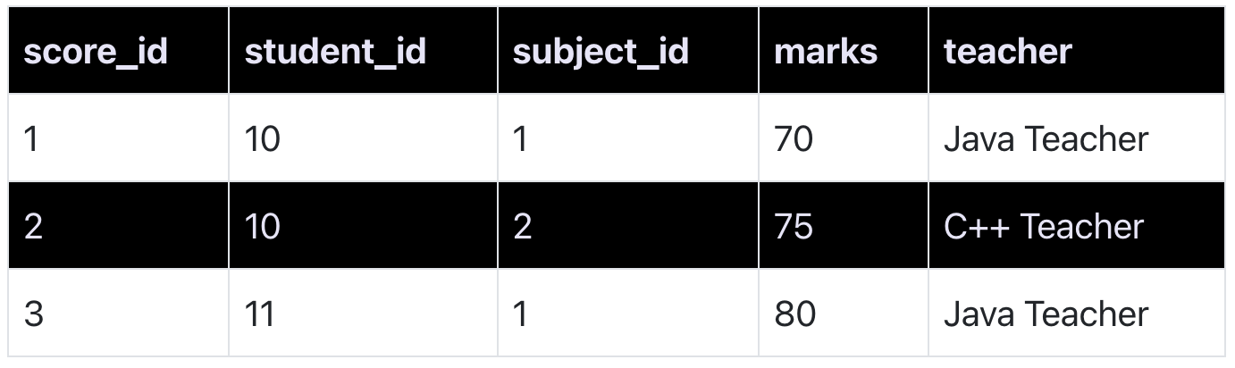
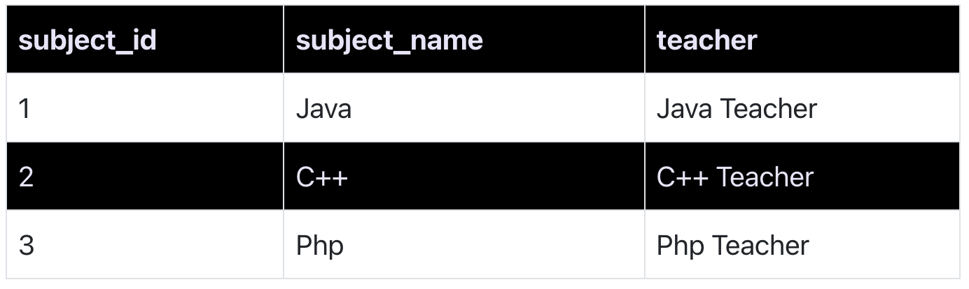
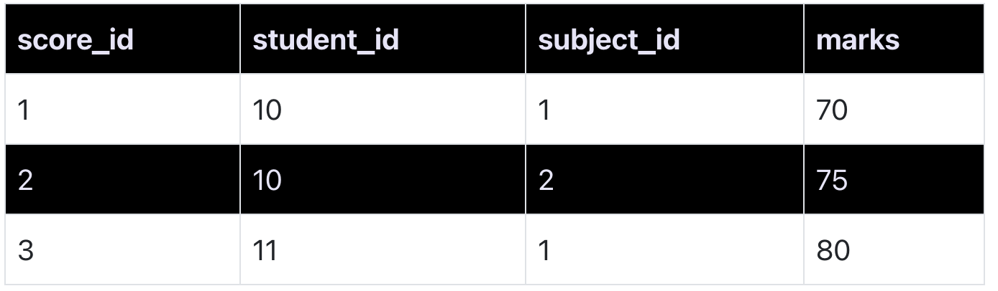
Second Normal Form
Definition
Table is in First Normal Form
No partial dependencies
Ex.
Notes:
Primary key is student_id + subject_id. But teacher only needs subject_id to be retrieved. Thus, teacher is partially dependent on the table’s primary key.

Slide 5
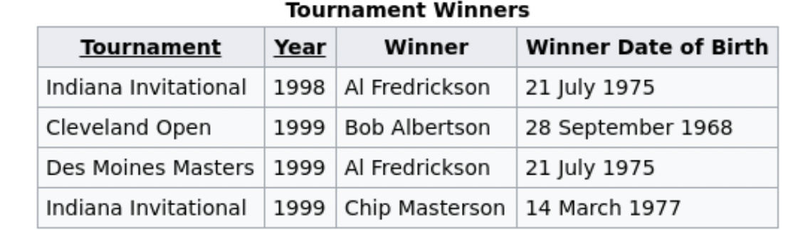
Second Normal Form
Definition
Table is in First Normal Form
No partial dependencies
Common, but not Tidy
Ex. Do you notice anything about this table?
Notes:
Primary key is student_id + subject_id. But teacher only needs subject_id to be retrieved. Thus, teacher is partially dependent on the table’s primary key.

Slide 6
Second Normal Form
Definition
Table is in First Normal Form
No partial dependencies
Common, but not Tidy
Ex. Do you notice anything about this table?
It’s about tournaments, but Winner Date of Birth is a static fact about a person
Notes:
Primary key is student_id + subject_id. But teacher only needs subject_id to be retrieved. Thus, teacher is partially dependent on the table’s primary key.

Slide 7
Second Normal Form
Definition
Table is in First Normal Form
No partial dependencies
Common, but not Tidy
Ex. Do you notice anything about this table?
It’s about tournaments, but Winner Date of Birth is a static fact about a person
Data is redundant (ex. Al’s birthday)
Winner Date of Birth belongs in a table about people
Notes:
Primary key is student_id + subject_id. But teacher only needs subject_id to be retrieved. Thus, teacher is partially dependent on the table’s primary key.

Slide 8
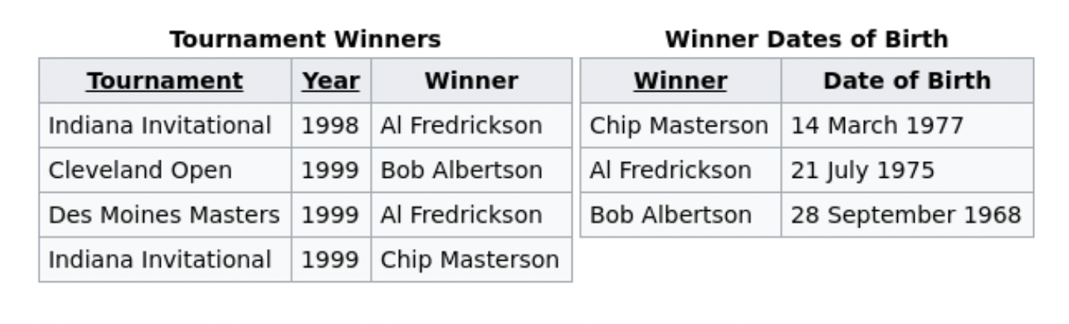
Third Normal Form
Definition
Table is in Second Normal Form
Non-primary columns depend only on primary key
Tidy!
Notes:
Primary key is student_id + subject_id. But teacher only needs subject_id to be retrieved. Thus, teacher is partially dependent on the table’s primary key.

Slide 9
Third Normal Form
Definition
Table is in Second Normal Form
Non-primary columns depend only on primary key
Tidy!
Characteristics
“Like is stored with like”
No redundant information
Tables tend to be:
Long (many rows)
Narrow (few columns)
Efficient for access and storage
Notes:
Primary key is student_id + subject_id. But teacher only needs subject_id to be retrieved. Thus, teacher is partially dependent on the table’s primary key.

Slide 10
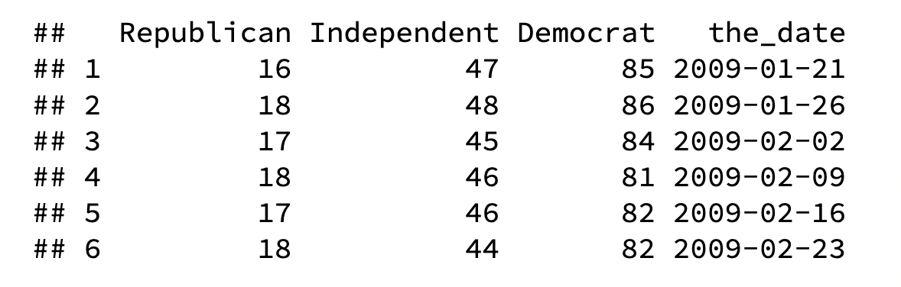
Tidy Data
Is this data Tidy?
Work with the person next to you to decide why or why not
Notes:
Primary key is student_id + subject_id. But teacher only needs subject_id to be retrieved. Thus, teacher is partially dependent on the table’s primary key.

Slide 11
Tidy Data
Is this data Tidy?
Work with the person next to you to decide why or why not
Not Tidy
Separate observations in one row (What if I want to compare Republican, Independent, and Democrat?)
Notes:
Primary key is student_id + subject_id. But teacher only needs subject_id to be retrieved. Thus, teacher is partially dependent on the table’s primary key.

Slide 12
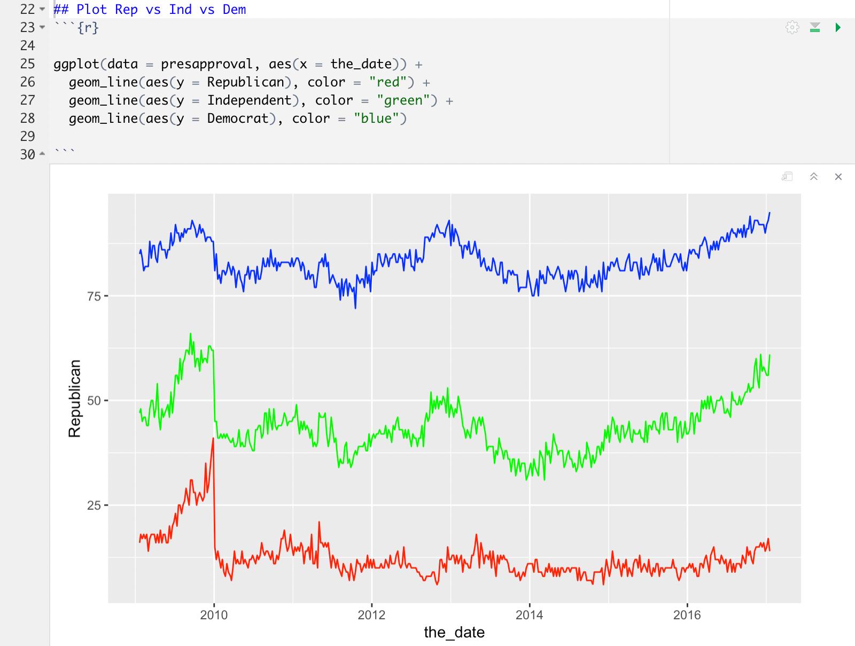
Tidy Data
Notes:
Primary key is student_id + subject_id. But teacher only needs subject_id to be retrieved. Thus, teacher is partially dependent on the table’s primary key.

Slide 13
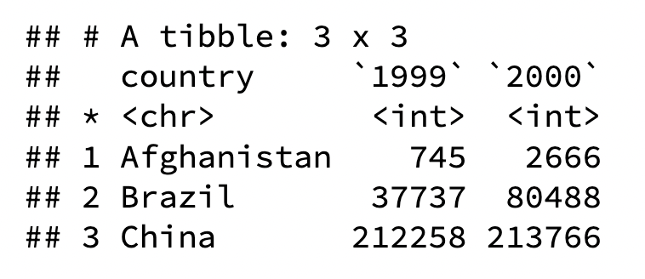
Tidy Data
Is this data Tidy?
Work with the person next to you to decide why or why not
Notes:
Primary key is student_id + subject_id. But teacher only needs subject_id to be retrieved. Thus, teacher is partially dependent on the table’s primary key.

Slide 14
Tidy Data
Is this data Tidy?
Work with the person next to you to decide why or why not
Not Tidy
Columns 1999 and 2000 contain separate observations for two different years (and should therefore be separate rows)
Column names contain important information (and should therefore be values)
Notes:
Primary key is student_id + subject_id. But teacher only needs subject_id to be retrieved. Thus, teacher is partially dependent on the table’s primary key.

Slide 15
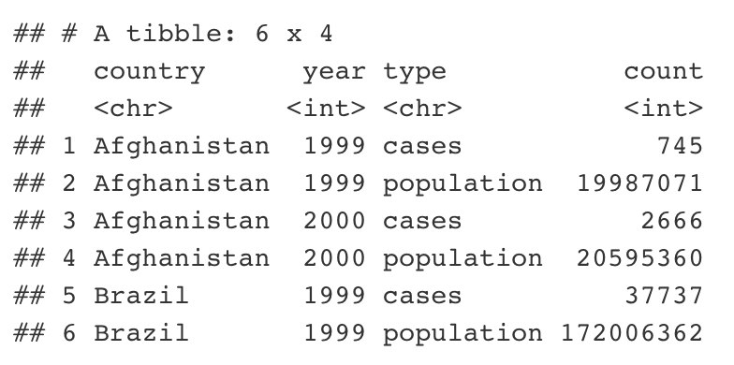
Tidy Data
Is this data Tidy?
Work with the person next to you to decide why or why not
Notes:
Primary key is student_id + subject_id. But teacher only needs subject_id to be retrieved. Thus, teacher is partially dependent on the table’s primary key.

Slide 16
Tidy Data
Is this data Tidy?
Work with the person next to you to decide why or why not
Not Tidy
Incompatible values in count column
cases and population data should each be in their own column
Notes:
Primary key is student_id + subject_id. But teacher only needs subject_id to be retrieved. Thus, teacher is partially dependent on the table’s primary key.

Slide 17
Tidy Data
How do we make data Tidy?
Notes:
Primary key is student_id + subject_id. But teacher only needs subject_id to be retrieved. Thus, teacher is partially dependent on the table’s primary key.

Slide 18
Tidy Data
How do we make data Tidy?
What needs to happen here?
Notes:
Primary key is student_id + subject_id. But teacher only needs subject_id to be retrieved. Thus, teacher is partially dependent on the table’s primary key.

Slide 19
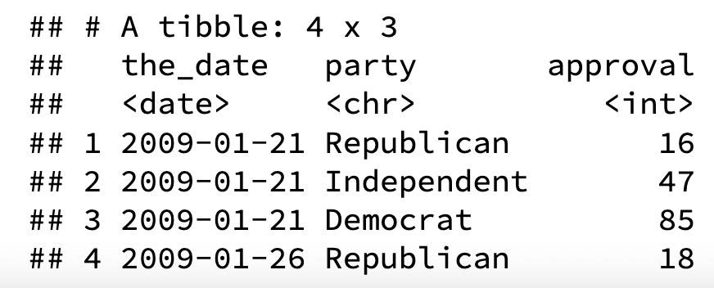
Tidy Data
How do we make data Tidy?
What needs to happen here?
Notes:
Primary key is student_id + subject_id. But teacher only needs subject_id to be retrieved. Thus, teacher is partially dependent on the table’s primary key.

Slide 20
Tidy Data
How do we make data Tidy?
What needs to happen here?
Notes:
Primary key is student_id + subject_id. But teacher only needs subject_id to be retrieved. Thus, teacher is partially dependent on the table’s primary key.

Slide 21
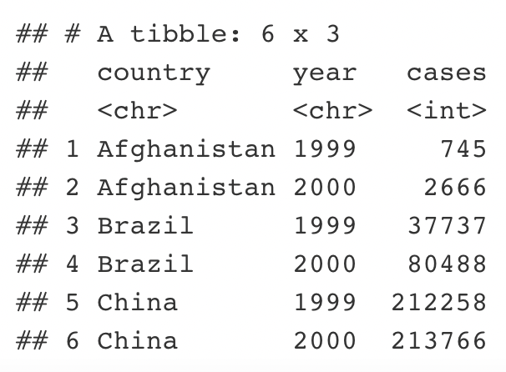
Tidy Data
How do we make data Tidy?
What needs to happen here?
Notes:
Primary key is student_id + subject_id. But teacher only needs subject_id to be retrieved. Thus, teacher is partially dependent on the table’s primary key.

Slide 22
Tidy Data
How do we make data Tidy?
What needs to happen here?
Notes:
Primary key is student_id + subject_id. But teacher only needs subject_id to be retrieved. Thus, teacher is partially dependent on the table’s primary key.

Slide 23
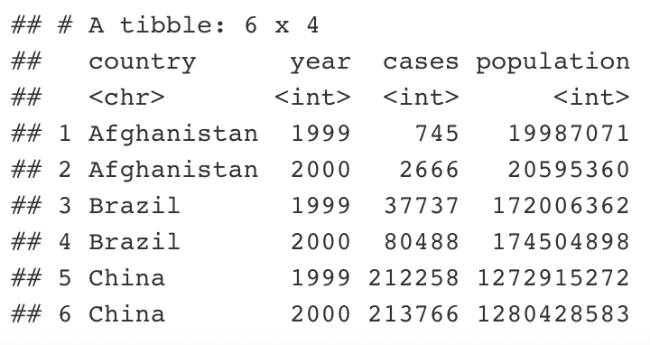
Tidy Data
How do we make data Tidy?
What needs to happen here?
Notes:
Primary key is student_id + subject_id. But teacher only needs subject_id to be retrieved. Thus, teacher is partially dependent on the table’s primary key.

Slide 24

tidyr
R package that helps make data tidy
We will primarily use two functions:
pivot_longer()
pivot_wider()
Notes:
Primary key is student_id + subject_id. But teacher only needs subject_id to be retrieved. Thus, teacher is partially dependent on the table’s primary key.

Slide 25
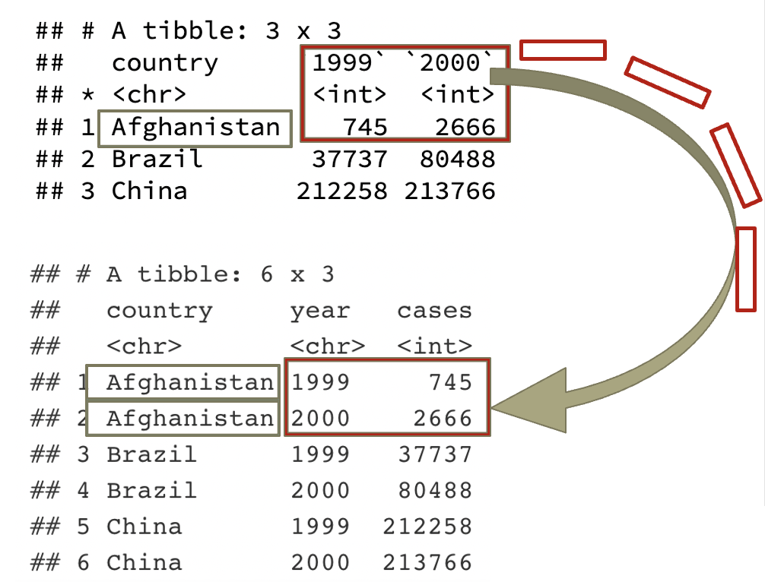
tidyr
pivot_longer()
wide → narrow
table4a %>%
pivot_longer(-country,
names_to = "year", values_to = "cases")
Notes:
Primary key is student_id + subject_id. But teacher only needs subject_id to be retrieved. Thus, teacher is partially dependent on the table’s primary key.

Slide 26
tidyr
pivot_longer()
wide → narrow
-country: pivot all columns except country
names_to = “year”: make a new column called year (into which we'll put the pivoted column names)
values_to = “cases”: make another new column called cases (into which we'll put the pivoted values)
table4a %>%
pivot_longer(-country,
names_to = "year", values_to = "cases")
Notes:
Primary key is student_id + subject_id. But teacher only needs subject_id to be retrieved. Thus, teacher is partially dependent on the table’s primary key.

Slide 27
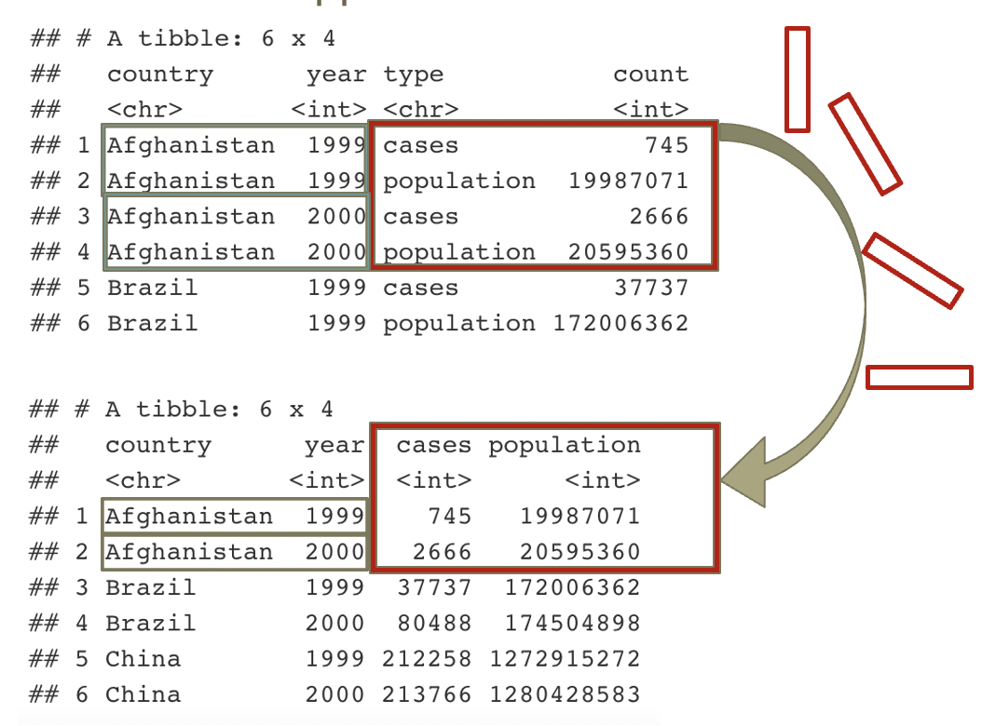
tidyr
pivot_wider()
narrow → wide
table2 %>%
pivot_wider(names_from = type,
values_from = count)
Notes:
Primary key is student_id + subject_id. But teacher only needs subject_id to be retrieved. Thus, teacher is partially dependent on the table’s primary key.

Slide 28
tidyr
pivot_wider()
narrow → wide
names_from = type: grab the values in the column called type (we'll pivot these values out to become the names of our new columns)
values_from = count: grab the values in the column called count (we'll pivot these across their corresponding columns)
table2 %>%
pivot_wider(names_from = type,
values_from = count)
Notes:
Primary key is student_id + subject_id. But teacher only needs subject_id to be retrieved. Thus, teacher is partially dependent on the table’s primary key.

Slide 29
Tidy Data
We tend to use pivot_longer() most often
Fill in the missing code below to pivot presapproval from wide form to long form.
presapproval_tidy <- presapproval %>%
pivot_longer(- ,
names_to = "",
values_to = "")
Notes:
Primary key is student_id + subject_id. But teacher only needs subject_id to be retrieved. Thus, teacher is partially dependent on the table’s primary key.

Slide 30
Tidy Data
-the_date: pivot everything except the_date
names_to = “party”: make a new column called party into which we’ll put pivoted column names
values_to = “approval”: make a new column called approval into which we’ll put pivoted values
presapproval_tidy <- presapproval %>%
pivot_longer(-the_date,
names_to = "party",
values_to = "approval")
Notes:
Primary key is student_id + subject_id. But teacher only needs subject_id to be retrieved. Thus, teacher is partially dependent on the table’s primary key.

Slide 31
Tidy Data
Notes:
Primary key is student_id + subject_id. But teacher only needs subject_id to be retrieved. Thus, teacher is partially dependent on the table’s primary key.

Slide 32
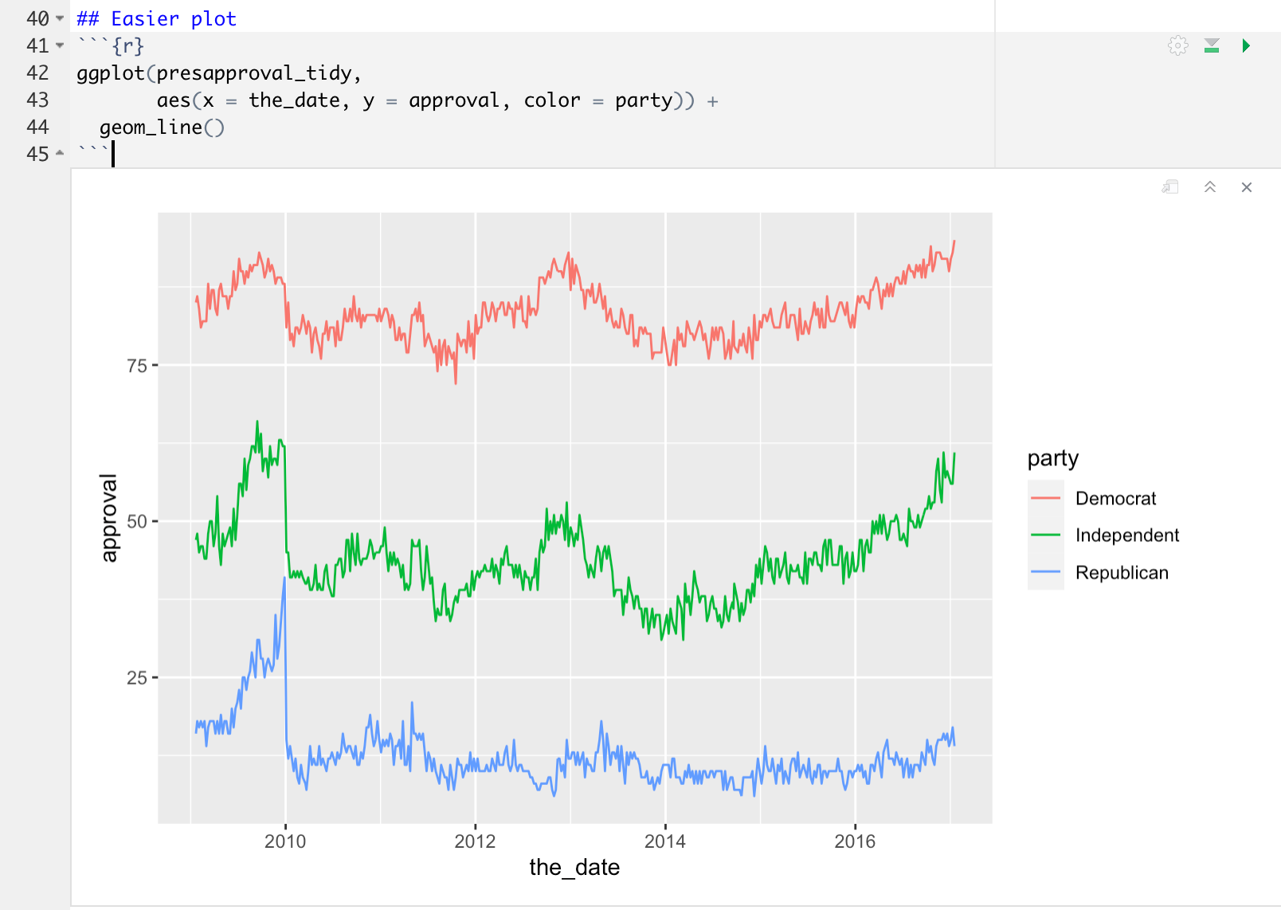
Tidy Data
Notes:
Primary key is student_id + subject_id. But teacher only needs subject_id to be retrieved. Thus, teacher is partially dependent on the table’s primary key.

